Slide 1

Sustainability Tracker – Carbon Footprint Copilot:
An AI-powered platform for tracking and reducing carbon emissions
Presented by : Maripeddi Navya
Chinnarathod Savitha Kalakoti sravya Kemidi Shivani Muduthanapally Meghana

Slide 2
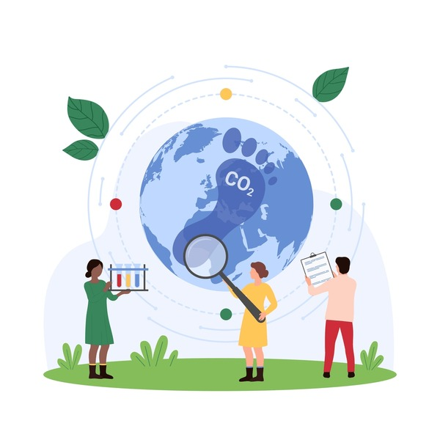
Abstract
The Sustainability Tracker – Carbon Footprint Copilot is an AI-powered solution designed to measure, analyze, and reduce carbon emissions generated by individuals and organizations. With rising concerns about climate change, there is an urgent need for accessible tools that simplify sustainability practices. Existing systems are either manual, complex, or lack real-time tracking capabilities.
Our proposed system leverages Microsoft Azure AI, Machine Learning, and Power BI to provide an intelligent Copilot that automatically tracks daily activities, estimates their carbon footprint, and delivers personalized recommendations to minimize environmental impact. The platform integrates data from user inputs, IoT devices, and external sources to generate actionable insights and sustainability dashboards.
By combining automation, personalization, and gamification, the solution empowers individuals to adopt greener lifestyles, helps enterprises comply with sustainability reporting, and supports governments and NGOs in driving eco-friendly initiatives. This project bridges the gap between awareness and action, making sustainability practical, measurable, and impactful.

Slide 3
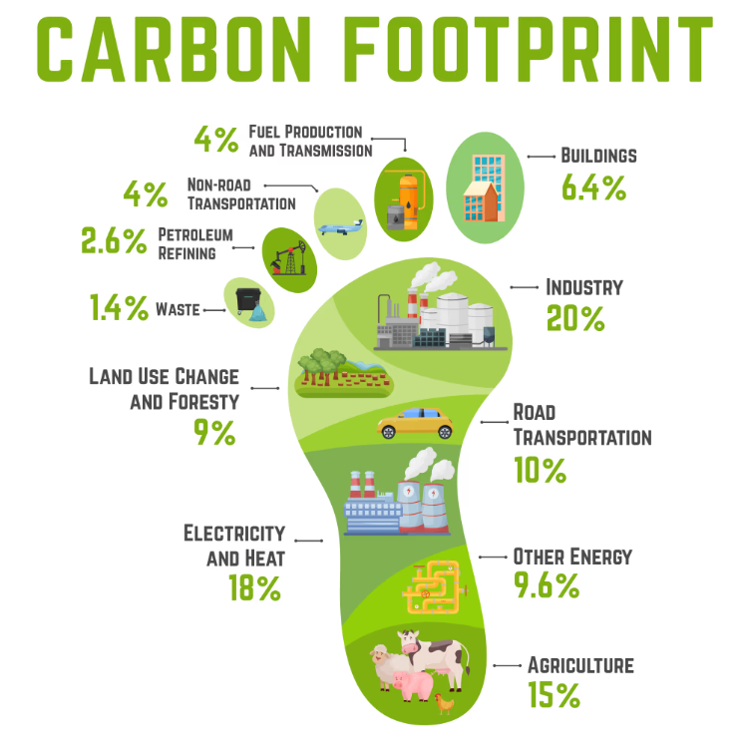
Introduction
Climate change is accelerating due to increasing greenhouse gas emissions, leading to rising global temperatures, shifting weather patterns, and severe environmental consequences. A major contributor to this crisis is the carbon footprint generated by human activities such as transportation, energy consumption, and industrial processes. Despite growing awareness, most existing tools for tracking emissions are static, complex, or lack actionable guidance, making it difficult for individuals and organizations to adopt sustainable practices.
Our proposed system leverages Microsoft Azure AI, Machine Learning, and Power BI to provide an intelligent Copilot that automatically tracks daily activities, estimates their carbon footprint, and delivers personalized recommendations to minimize environmental impact.
• Climate change is a global challenge caused by greenhouse gas emissions.
• Carbon footprint = measure of CO₂ released by daily activities.
• Individuals & businesses lack simple, AI-powered tools for tracking emissions.
• Our solution: Carbon Footprint Copilot – AI assistant to track, analyze, and minimize carbon impact.

Slide 4
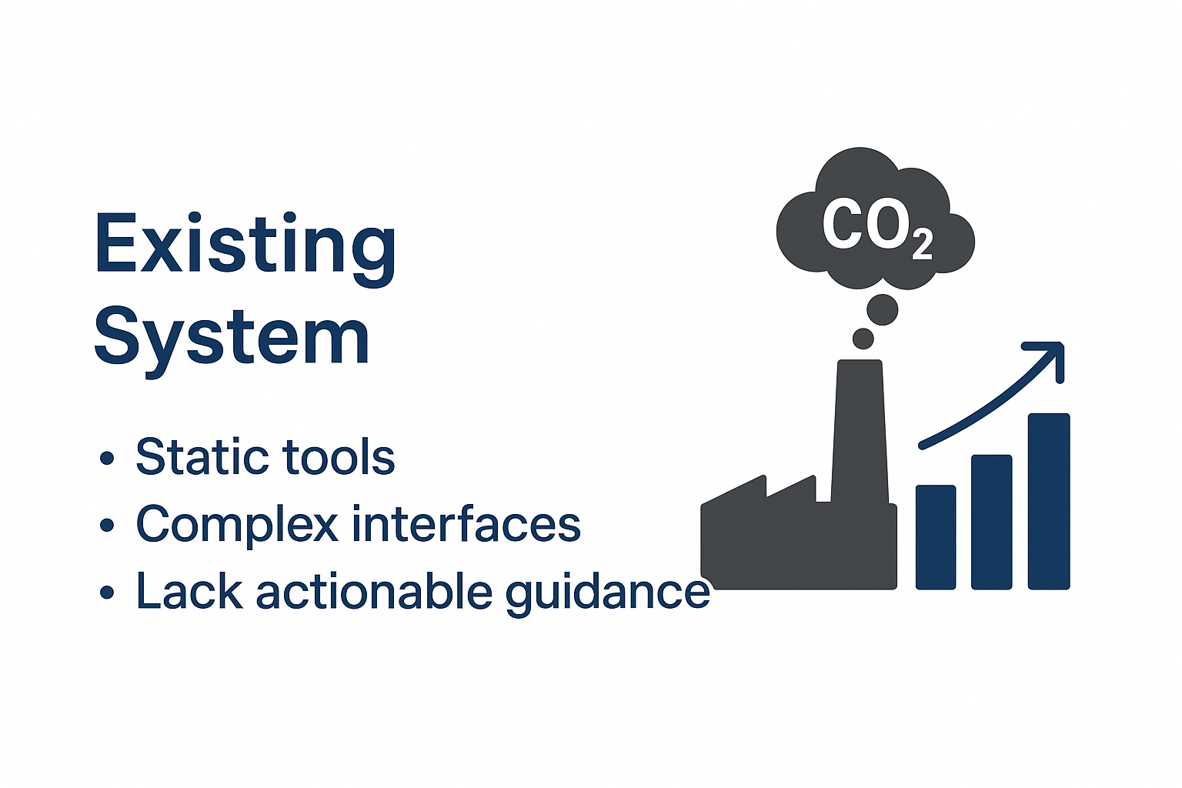
Existing System
Current carbon footprint tracking solutions are mostly static calculators or mobile apps that require manual data entry. They provide only approximate values and lack real-time tracking, making it difficult for users to understand their true environmental impact. Additionally, these tools often fail to offer personalized insights or actionable recommendations, limiting their practical usefulness.
Limitations:
Manual data entry leads to inaccuracy.
No real-time monitoring of activities.
Limited personalization in recommendations.
Lack of integration with IoT devices and cloud analytics
Provides only static reports without actionable guidance.

Slide 5

Proposed System
The proposed system overcomes the limitations of traditional models it leverages machine learning, natural language processing, and cloud integration to provide dynamic, actionable insights.
Techniques:
Machine Learning Regression Models to estimate and predict carbon emissions based on user activity.
Natural Language Processing (NLP) to process user queries and generate easy-to-understand insights.
Recommendation Systems (Collaborative + Content-based Filtering) to suggest tailored eco-friendly alternatives.
Time-Series Forecasting (ARIMA / LSTM) to predict future emission patterns.
Anomaly Detection Algorithms to detect unusual spikes in carbon usage.

Slide 6
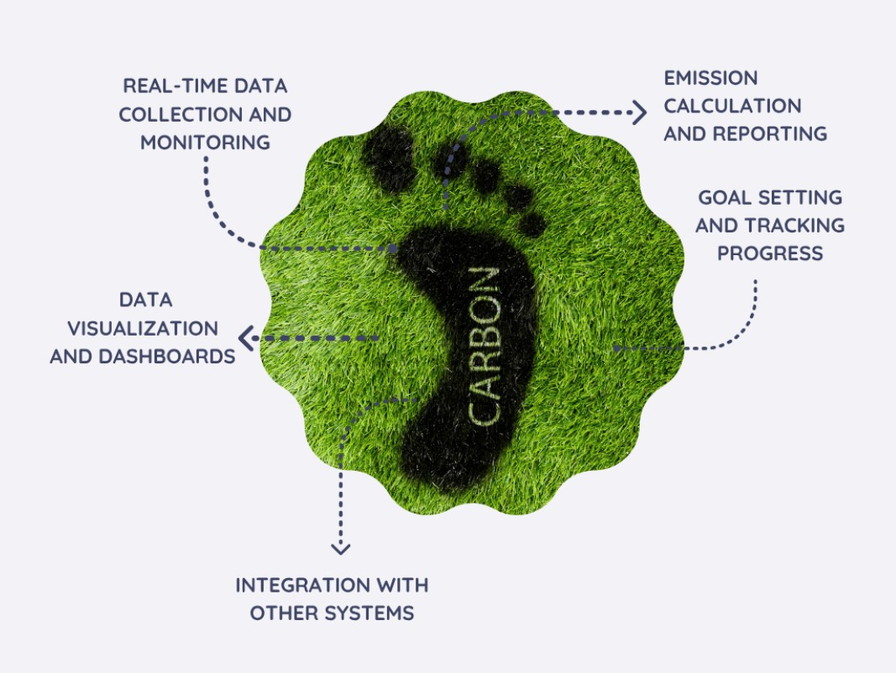
APPLICATIONS/FEATURES The system empowers individuals, businesses, and organizations to align their daily activities with global climate goals. Key Features
Real-time tracking of energy, transportation, and lifestyle activities.
Personalized recommendations for reducing carbon emissions.
Interactive dashboard with interpretable insights and trends.
Integration with IoT devices, wearables, and smart meters.
Cloud-based data storage and analytics for scalability.
Gamified sustainability scores to motivate eco-friendly behavior.

Slide 7
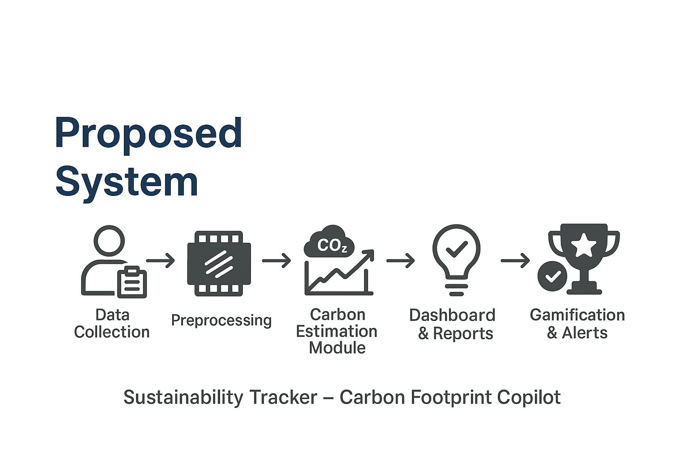





Modules :Program Flow
Data Collection
user inputs, IoT sensors, travel/energy data.
preprocessing
clean & categorize activity data.
Carbon Estimation Module
ML model converts activities to CO₂ equivalent.
Dashboard & Reports
Power BI visualization for tracking.
Gamification & Alerts
eco-scores, rewards, notifications.

Slide 8
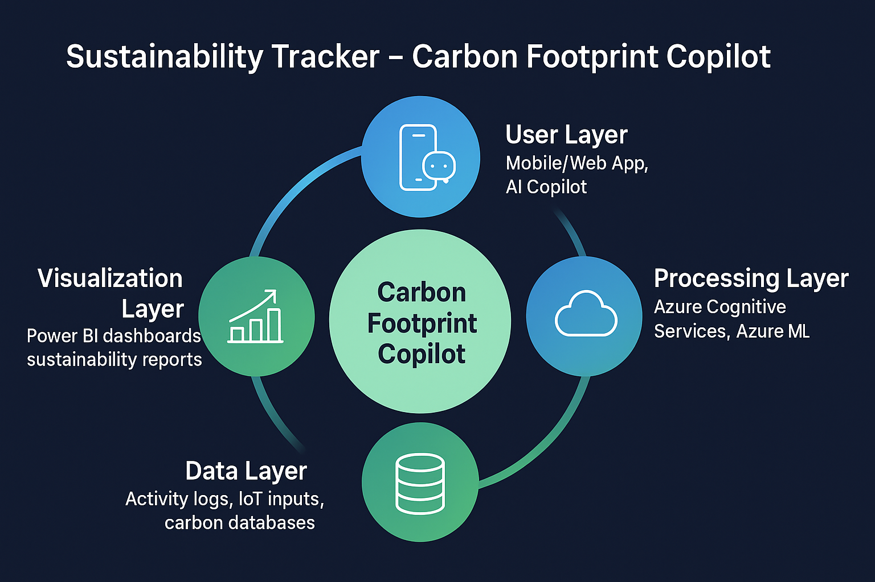
System Architecture

Slide 9
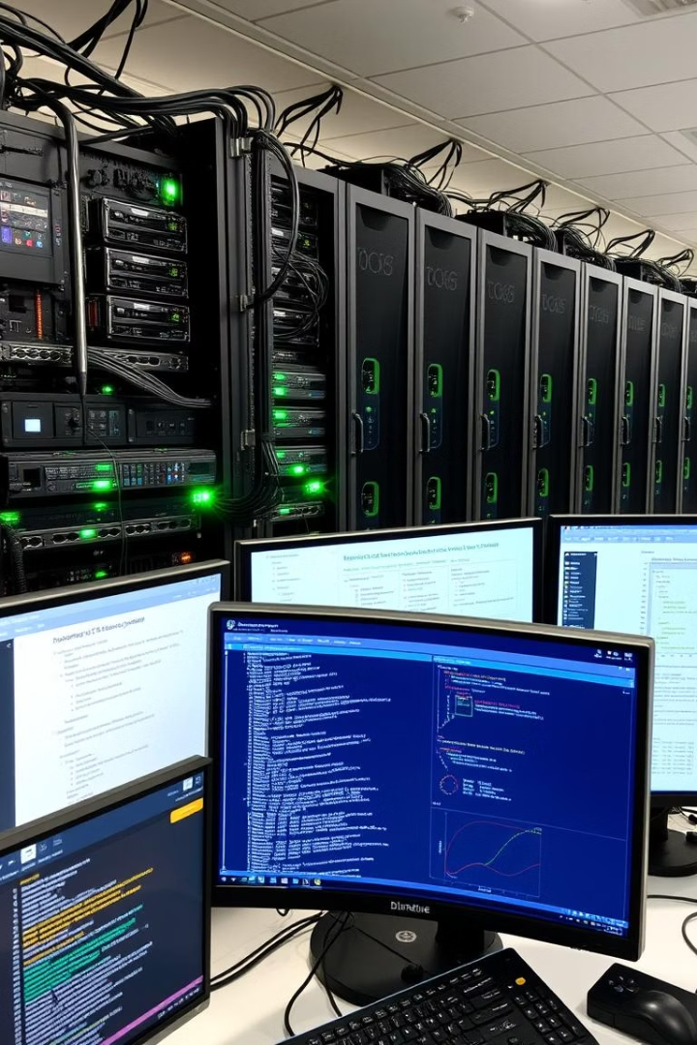
Software and Hardware Requirements
Software
Operating system : Windows / Linux / macOS
Coding Language : Python, (ML algorithms)
Front-End : React.js / Streamlit
Back-End : FastAPI
Data Base : PostgreSQL / MongoDB /
Azure Cosmos DB.
power BI (dashboards)

Slide 10

Hardware
➢ Processor - Pentium –IV
➢ RAM - 4 GB (min)
➢ Hard Disk - 20 GB
➢ Key Board - Standard Windows Keyboard
➢ Mouse - Two or Three Button Mouse
➢ Monitor - SVGA

Slide 11

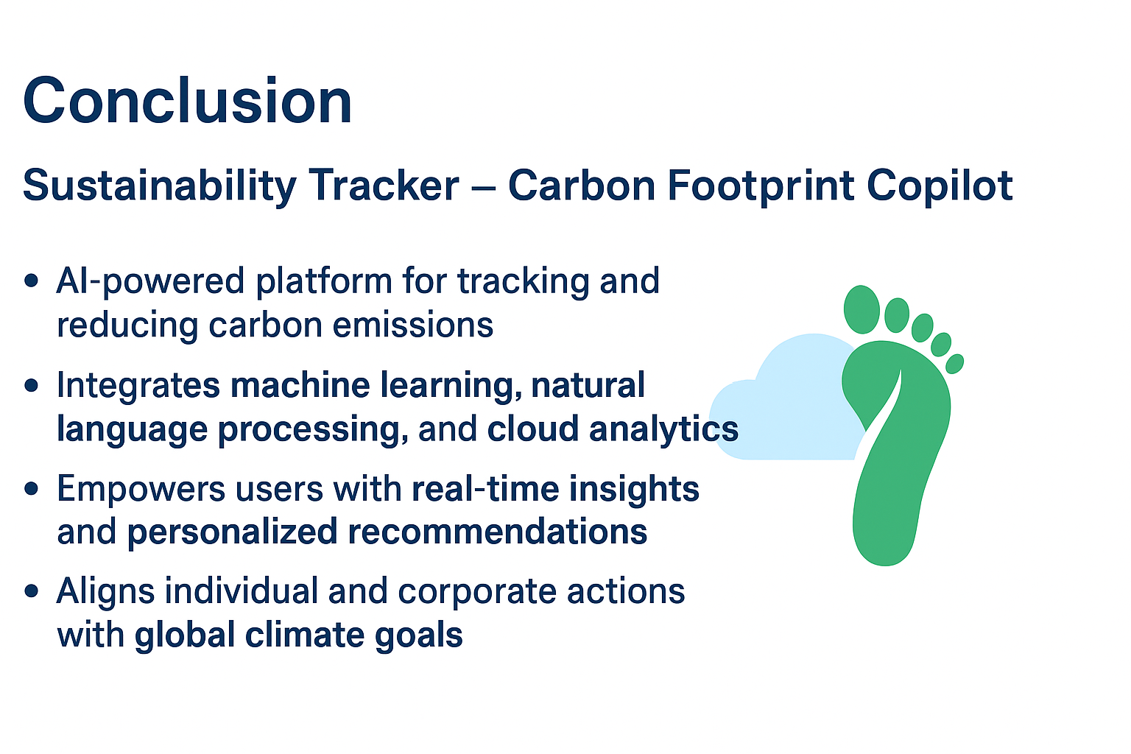

Slide 12


